Slide 1

DEEP LEARNING-BASED AUTOMATIC MUSIC TRANSCRIPTION USING CR-GCN
By
126003238 Selvakarthik S 126003241 Shanthosh Kumar R 126003218 Rithvik L
Project Guide – Dr. Emily Jenifer A

Slide 2
MOTIVATION
Music is a major stress-buster for billions around the world. While we listen to millions of songs each year, certain tunes stay with us in our minds.
Musicians often transcribe these melodies into music sheets to aid in composition and performance.
Our goal is to convert a piece of music into its corresponding notes using a CR-GCN model.
To make this process accessible to everyone, we plan to develop a web application where users can upload a music file, and our model will generate the corresponding music notes, which will be displayed as a music sheet within the application.

Slide 3
OBJECTIVE
To develop an approach to convert an audio file (music) into its corresponding musical notes.
To identify and leverage efficient feature selection algorithms.
To select and utilise suitable classification algorithms.
To construct a model with the highest possible accuracy through rigorous training and testing on large datasets.
To deploy the model as a back-end in an user-friendly web application.

Slide 4
BASE PAPER
[1] Xiao, Z., Chen, X., & Zhou, L. (2023). Polyphonic piano transcription based on graph convolutional network. Signal Processing, 212, 109134.
Doi : https://doi.org/10.1016/j.sigpro.2023.109134

Slide 5
To design an Automatic Music Transcription (AMT) system that accurately converts complex polyphonic audio signals into symbolic music representations by capturing note interdependencies and temporal dynamics.
To deploy the model as a back-end in an user-friendly web application.
PROBLEM STATEMENT

Slide 6
ABSTRACT
The task of automatic music transcription (AMT) mainly focuses on converting audio signals to symbolic music representations, facilitating applications such as computational musicology and music analysis.
One of the biggest problems is when multiple notes are played at the same time, dimension explosion can happen which makes it difficult for accurate music note transcription.
To overcome this challenge, we have proposed a hybrid deep learning architecture combining Convolutional Neural Network for spatial feature extraction, bidirectional LSTMs or self-attention mechanisms for precise temporal note-level predictions and Graph Convolutional Network for accurate label learning to capture note interdependencies in polyphonic music.
Experiments on public datasets like MAESTRO, MAPS, GiantMIDI show that the proposed methodology with F1-score of 96.88% is much more superior than existing methodologies like Onset and Frames, Wavenet, Non-Negative Matrix Factorization (NMF).
The generated music sheets validate the model’s accuracy and practical applicability, providing a valuable tool for musicians and researchers.
By addressing the limitations of prior methods, the proposed approach CR-GCN (Channel Relationship-Based Graph Convolutional Network) represents a step forward in automated transcription technology, making it feasible for large-scale and real-time applications.

Slide 7
LITERATURE SURVEY
TITLE | MERITS | DEMERITS
A Data-Driven Analysis of Robust Automatic Piano Transcription | The study improved note-onset accuracy to 88.4 F1-score on the MAPS dataset through data augmentation. | Performance on out-of-distribution annotated piano data indicates challenges in generalizing to unseen data.
Automatic Piano Sheet Music Transcription with Machine Learning | BiLSTM architecture is identified as one of the effective for automatic piano music transcription, achieving a top F1-score of 74.80%. | CNNs underperform significantly in music transcription tasks, achieving only an F1-score of 22.85% despite extensive hyper-parameter tuning.
Research on the Recognition of Piano-Playing Notes by a Music Transcription Algorithm | The CRNN algorithm combines CNN and BiLSTM, achieving impressive F1-scores of 84.90%, 92.24%, and 79.27% for frames, notes, and offsets. | The study's results have limited generalizability due to small datatset, with further exploration of different piano note features needed to enhance recognition accuracy.
Multimodal Image and Audio Music Transcription | The multimodal framework combining OMR and AMT improves transcription accuracy by reducing errors up to 40% for more accurate music transcription. | The proposed framework can degrade overall transcription accuracy if either OMR or AMT already performs near-perfectly. Overall Transcription may degrade
Automatic Piano Music Transcription Using Audio-Visual Features | This research uses audio-visual features to improve piano music transcription accuracy by 12.69%, surpassing audio-only systems. | The system's dependency on specialized equipment, like an overhead camera, limits its practicality for general use

Slide 8
MODULE
MODULE 1: DATA PREPROCESSING AND DATA SPLITTING
MODULE 2: FEATURE LEARNING USING CNN + LSTM
MODULE 3: LABEL LEARNING USING GCN
MODULE 4: RESULTS AND OBSERVATION (so far)
MODULE 5: DEPLOYMENT

Slide 9
MODULE 1: DATA PREPROCESSING
As per the dataset we have incorporated into our project (Maestro v3), the categorical X attribute consists of .wav audio files.
To enhance performance of our model, it is required to convert the .wav files into its corresponding mel-spectrograms which is achieved using the librosa module of python.
A mel spectrogram is a visual representation of an audio signal's frequency content over time, using the mel scale on the y-axis and decibel scale for amplitude, making it more aligned with human auditory perception.
The mel-spectrogram consists of the frequency (in hz) in y-axis and time in x-axis (in s) and also the sound-level (in db) is depicted as a third parameter with variation in colors.
Mel spectrograms provide an estimate of the short-term, time-localized frequency content of an audio signal, making them useful for analyzing how audio patterns change over short intervals of time.

Slide 10
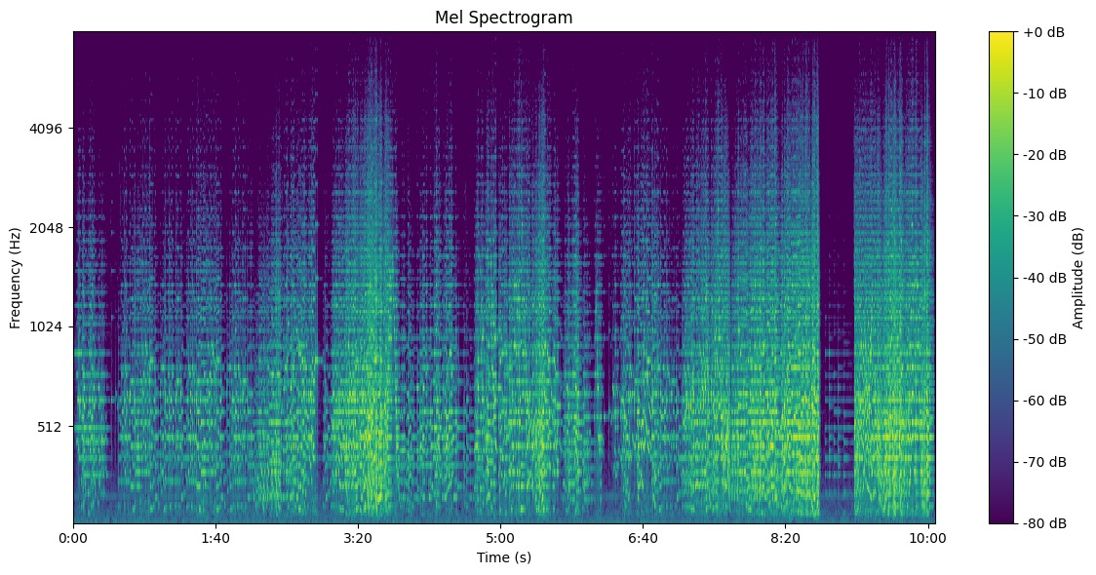

Slide 11
MODULE 1: DATA PREPROCESSING
As per the dataset we have incorporated into our project (Maestro v3), the categorical Y attribute consists of .midi files.
To enhance performance of our model, it is required to convert the .midi files into its corresponding piano rolls (tsv files) which is achieved using the pretty_midi module of python.
A piano roll is a visual representation of musical notes over time, where notes are depicted as horizontal lines or bars on a grid, with the vertical axis representing pitch and the horizontal axis representing time.
The piano roll consists of the midi notes (from 21-108) in y-axis and time in x-axis (in s) and also whether the note is pressed or not is depicted as a third parameter with variation in hues.
Piano rolls can also convey additional information such as note duration and velocity, which can be represented through variations in line length and color intensity, respectively, providing a comprehensive view of musical performance dynamics.

Slide 12
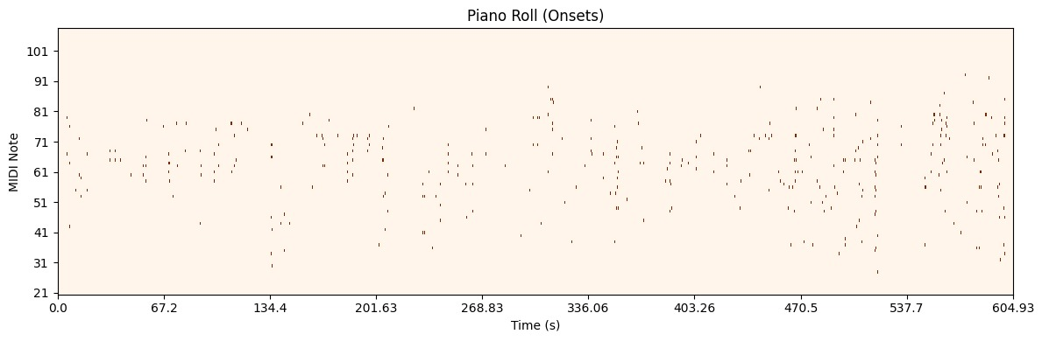

Slide 13
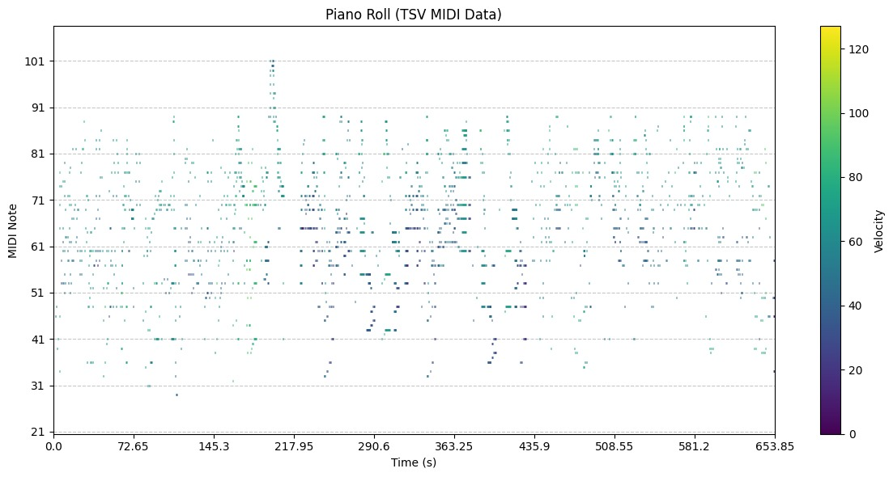

Slide 14
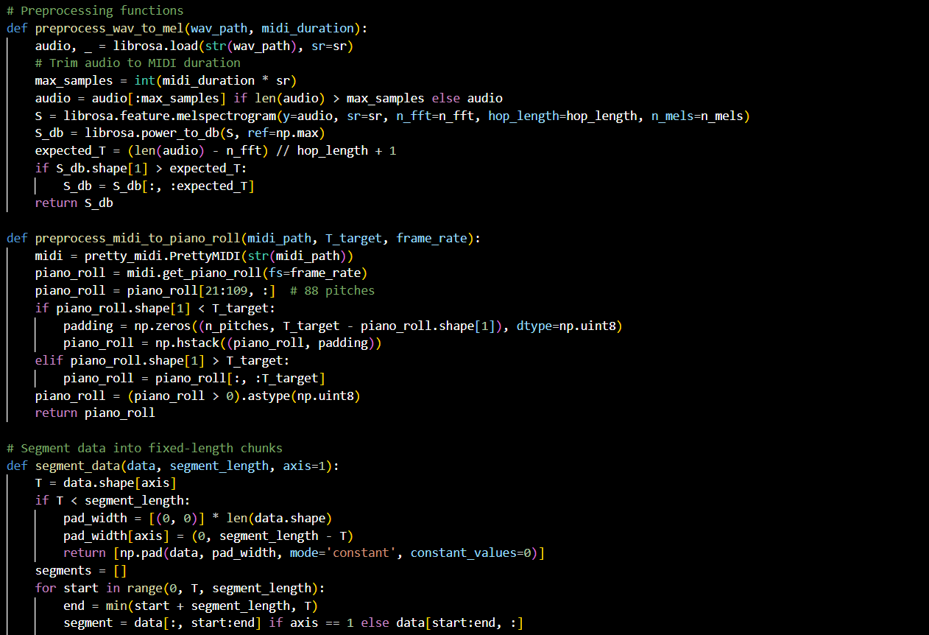
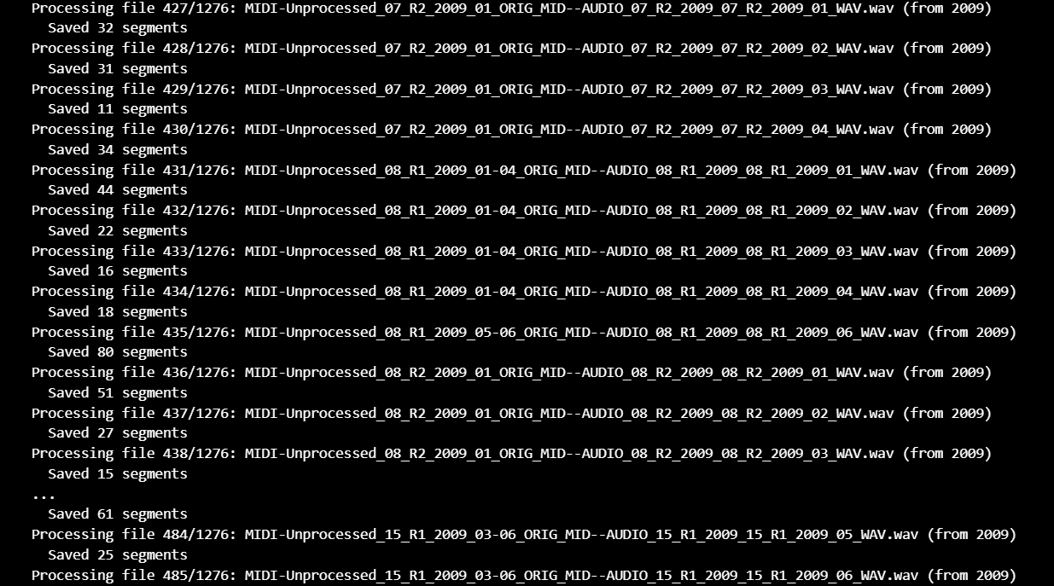
MODULE 1: DATA PREPROCESSING
Output:

Slide 15
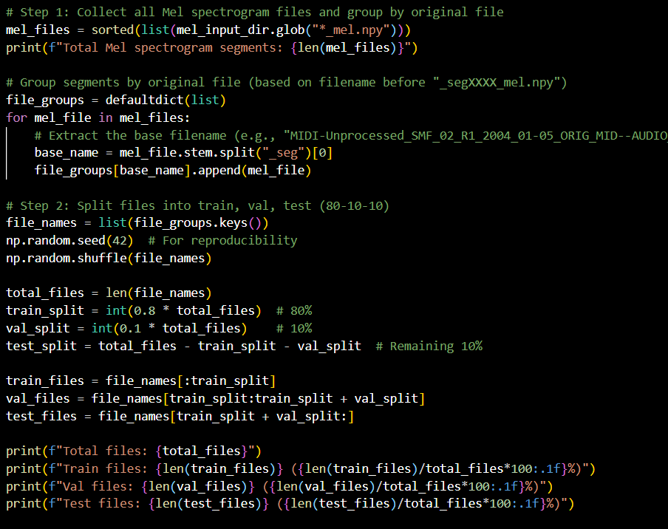
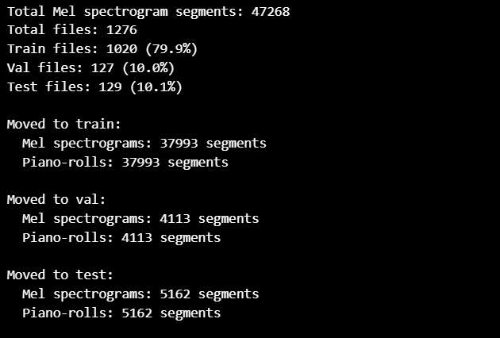
MODULE 1: DATA SPLITTING
Output:

Slide 16
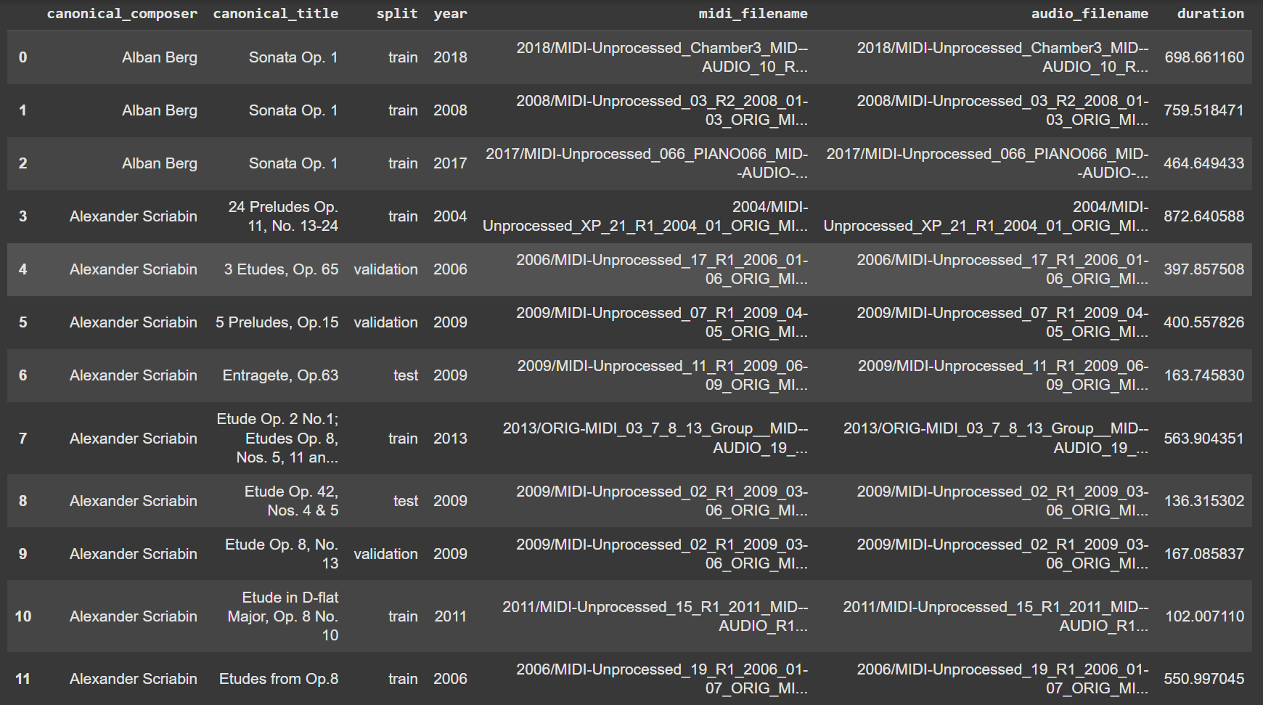
METADATA

Slide 17
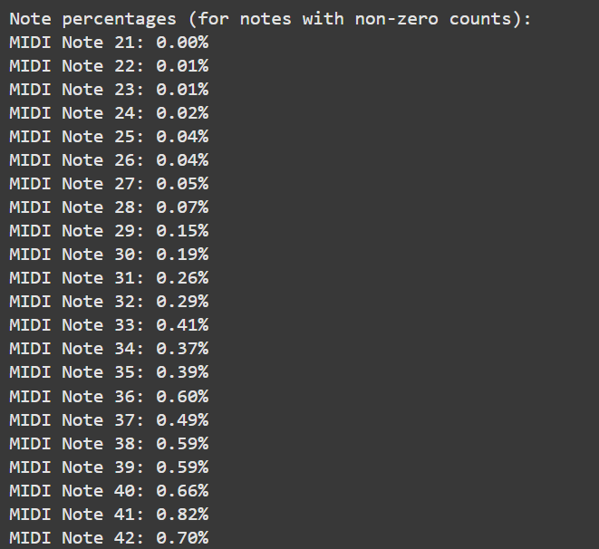
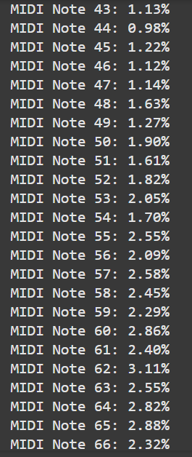
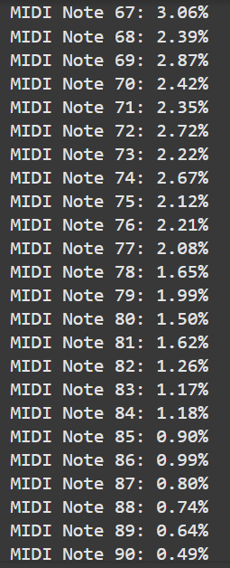
MODULE 1: DATA VISUALIZATION

Slide 18
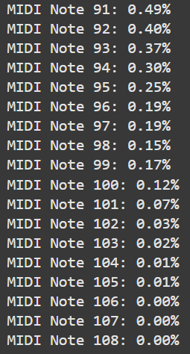
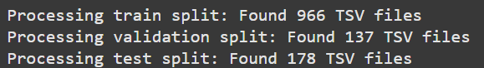
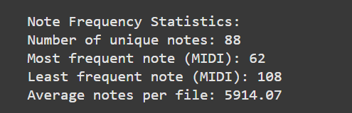
MODULE 1: DATA VISUALIZATION

Slide 19
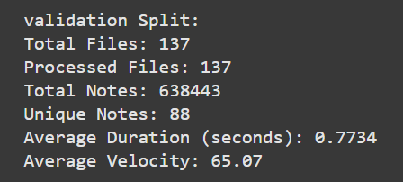
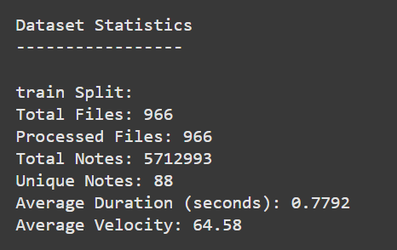
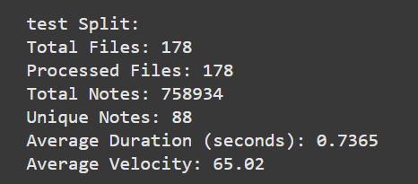
MODULE 1: DATA VISUALIZATION

Slide 20
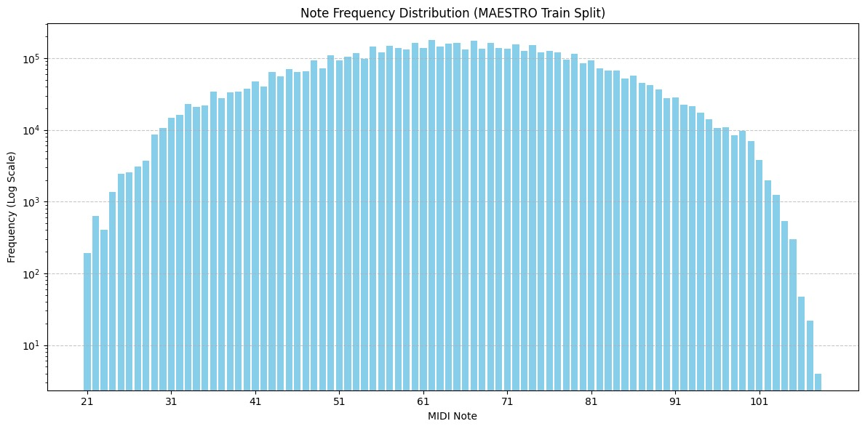

Slide 21
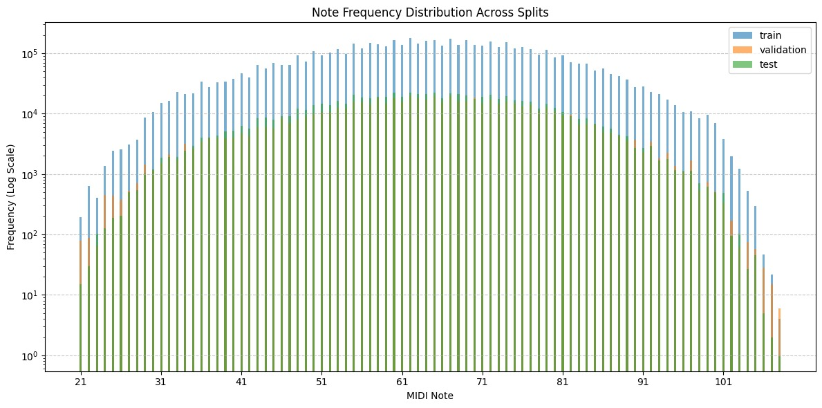

Slide 22
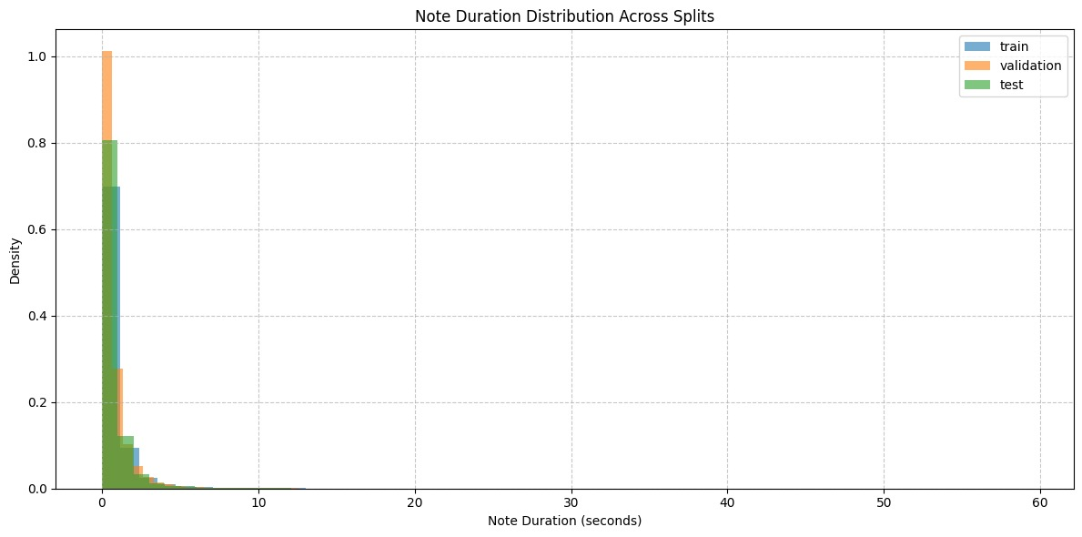

Slide 23
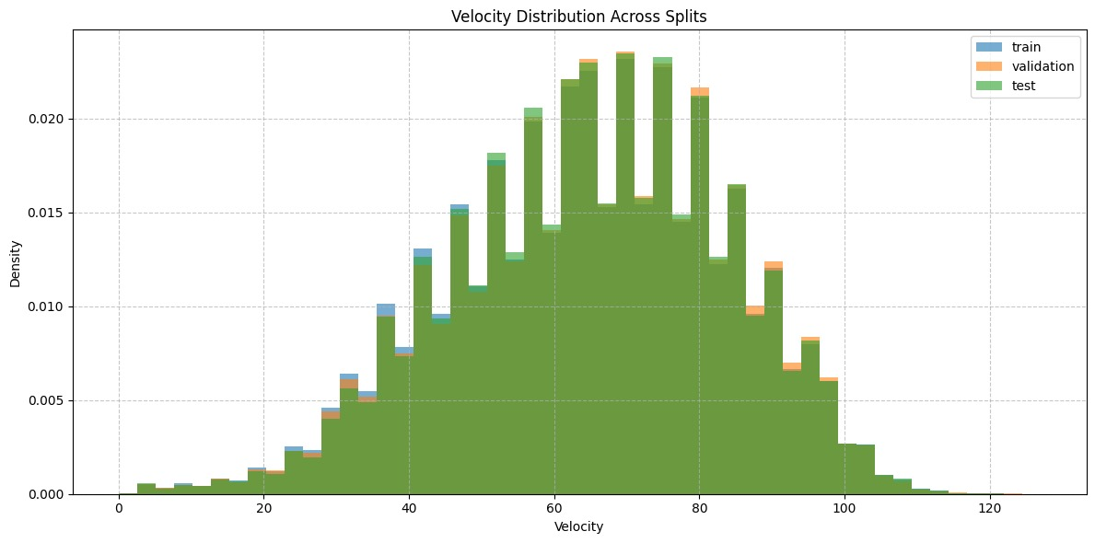

Slide 24
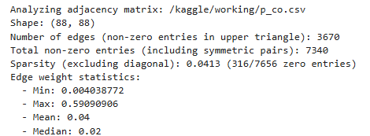
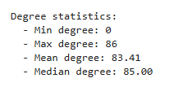

Slide 25
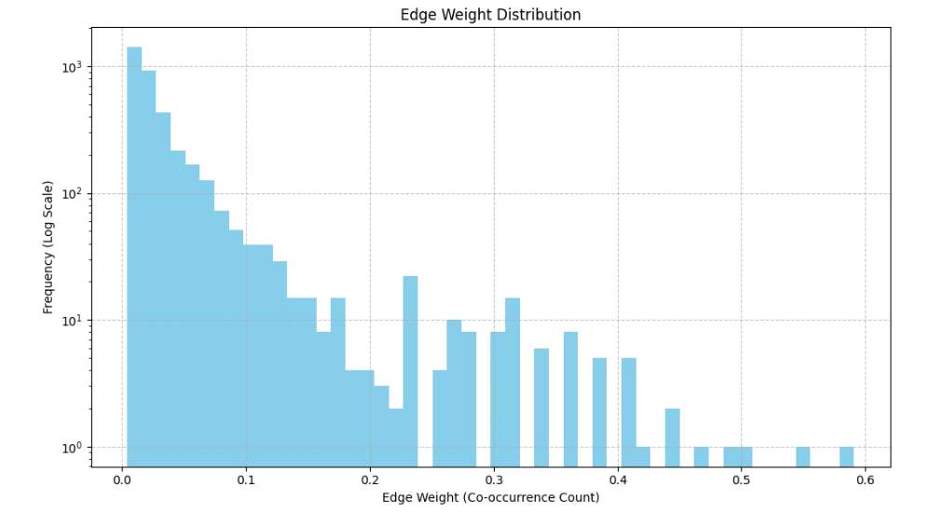

Slide 26
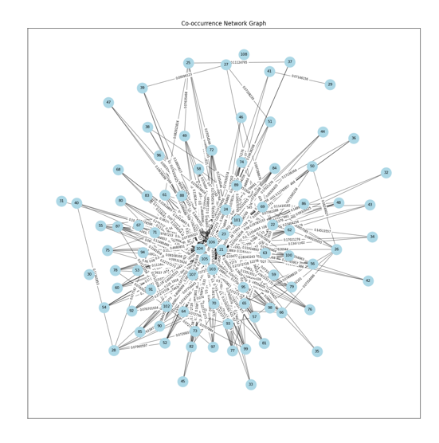

Slide 27
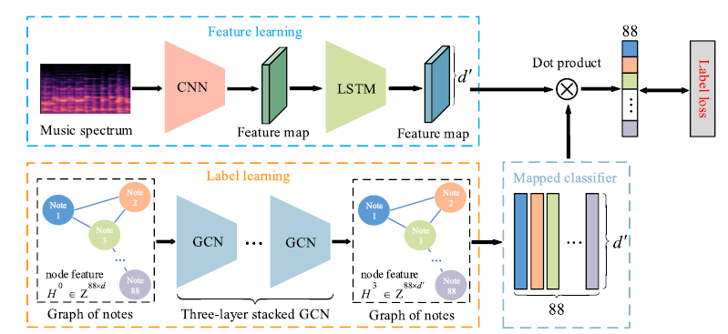
EXISTING SYSTEM

Slide 28
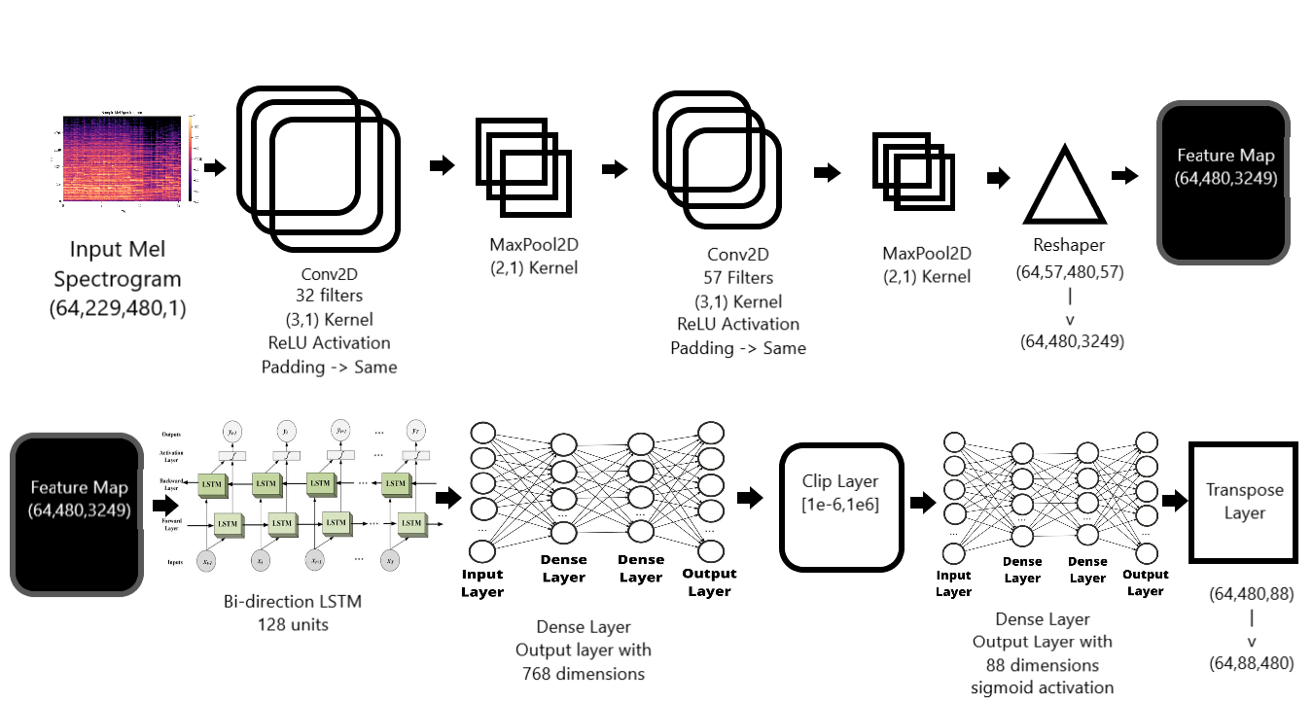
MODULE 2: FEATURE LEARNING CNN + LSTM

Slide 29
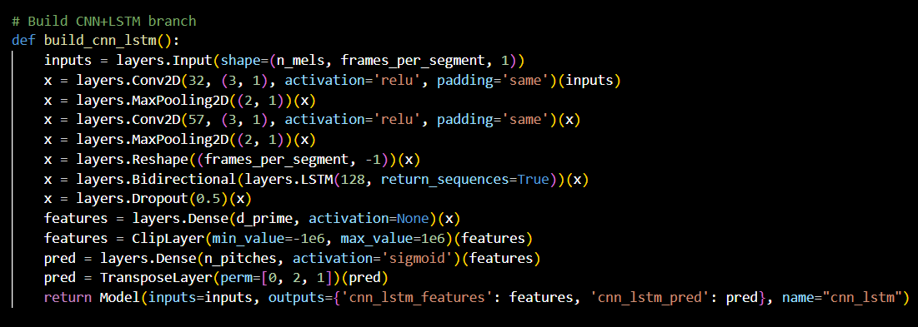
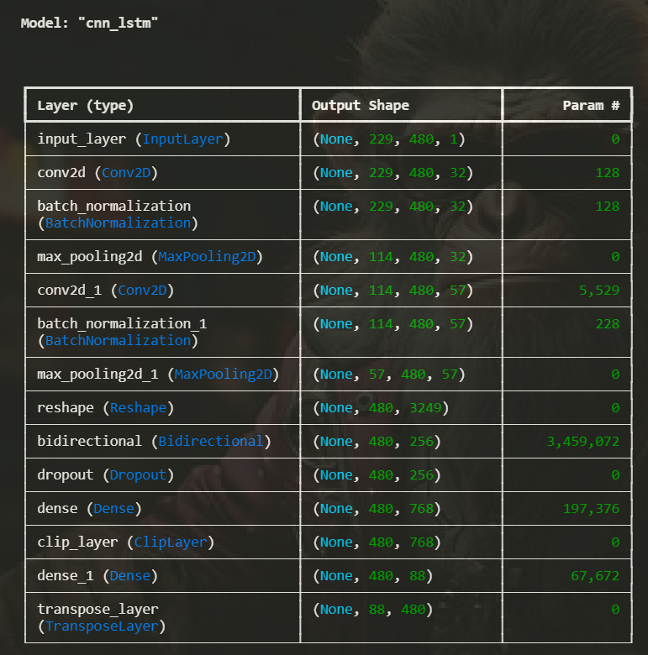
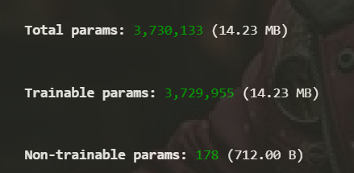
MODULE 2: FEATURE LEARNING CNN + LSTM
Output:

Slide 30
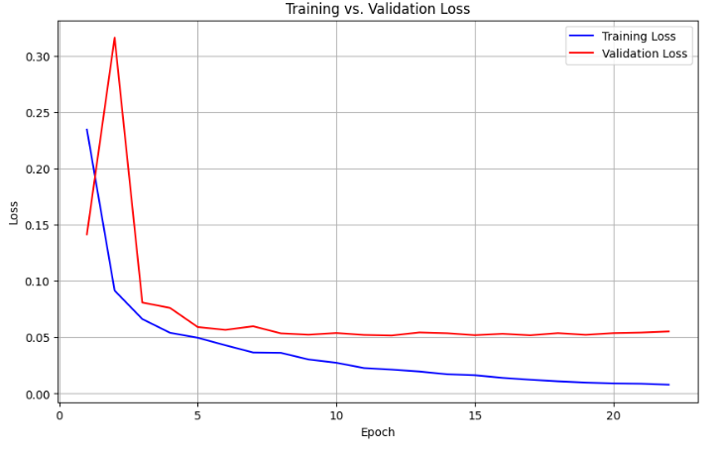
RESULTS OF FEATURE LEARNING ONLY
Frame Level Precision | Frame Level Recall | Frame Level F1 Score
0.5200 | 0.4800 | 0.4990
Note Level Precision | Note Level Recall | Note Level F1 Score
0.8200 | 0.7800 | 0.7995
Note with Offset Level Precision | Note with Offset Level Recall | Note with Offset Level Level F1 Score
0.5200 | 0.4800 | 0.4990

Slide 31
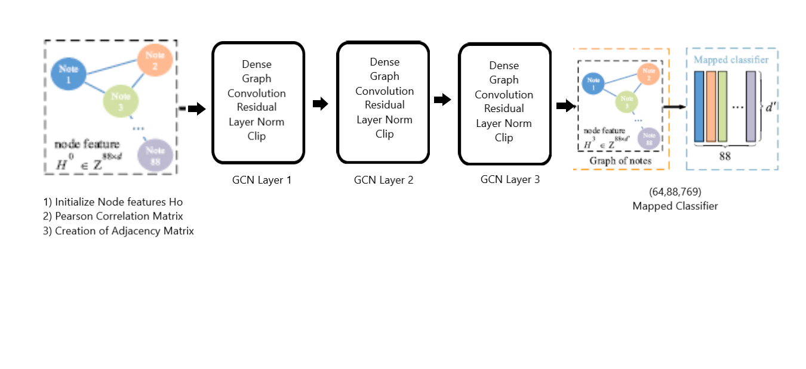
MODULE 3: LABEL LEARNING USING GCN
Feature Concatenation:
Dot product of feature map from CNN + LSTM and Mapped Classifier from GCN to compute Label loss and train our model

Slide 32
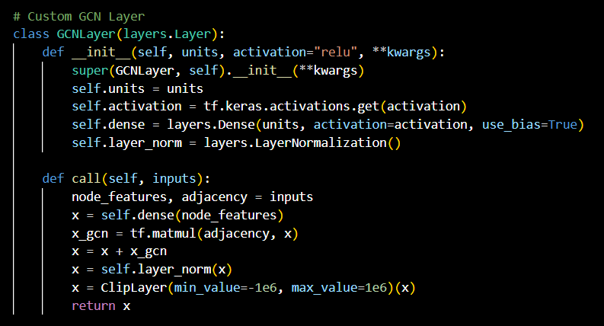
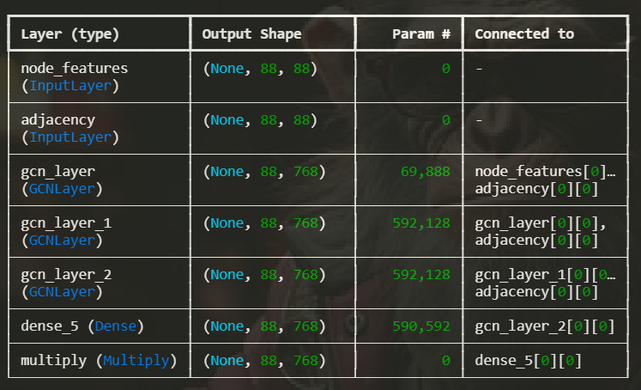
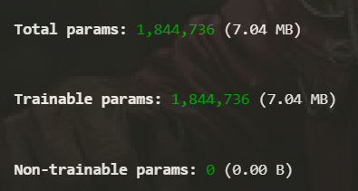
MODULE 3: LABEL LEARNING USING GCN
Output:

Slide 33
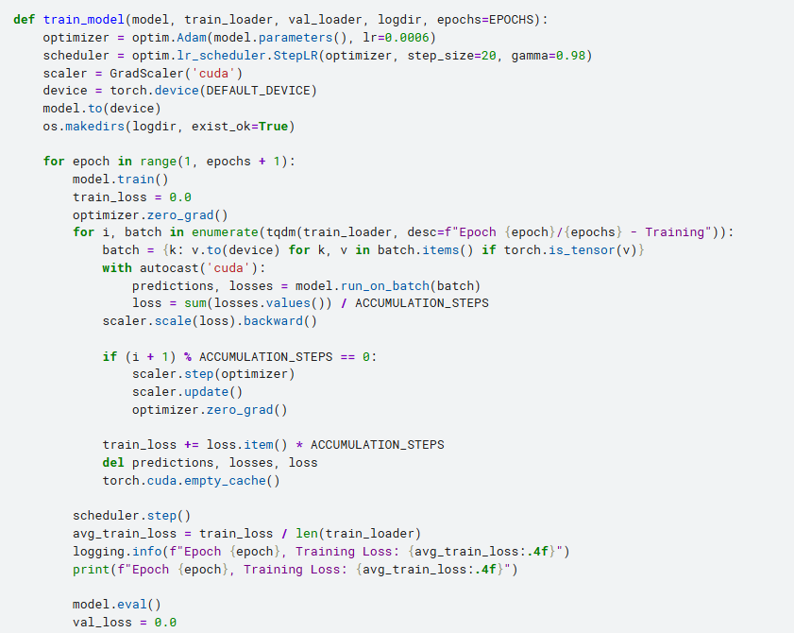
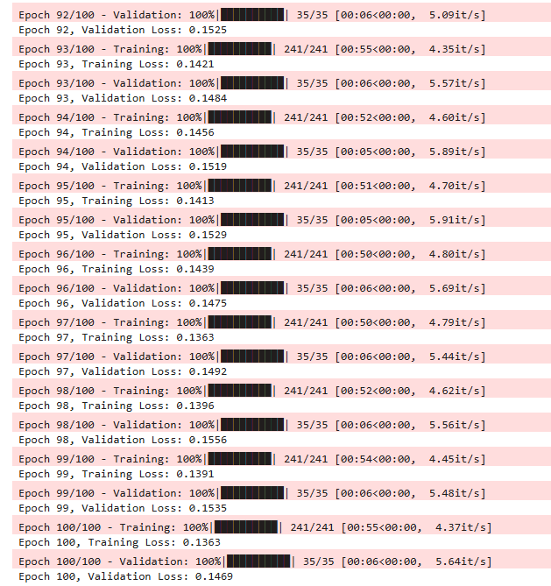
MODULE 3: Training Model
Output:

Slide 34
MODULE 4: RESULTS
The training journey for the CR-GCN model involved multiple iterations, starting with data preprocessing and refining the model to achieve a final frame-level F1 score of 0.8588 , Note-Level F1 score of 0.8508 and
Note with Offset-Level F1 score of 0.8510.
Training for fewer epochs initially helped identify errors, leading to adjustments in learning rate schedules, focal loss parameters, and model architecture, culminating in a 100-epoch run with early stopping.
The final model used a batch size of 8, focal loss with class weighting, and custom metrics, achieving balanced precision and recall (Not as required) suggesting post-processing needs.
Suggestions for future work include exploring deeper architectures, data augmentation, regularization and advanced post-processing , potentially improving precision, recall and F1 scores further more .

Slide 35
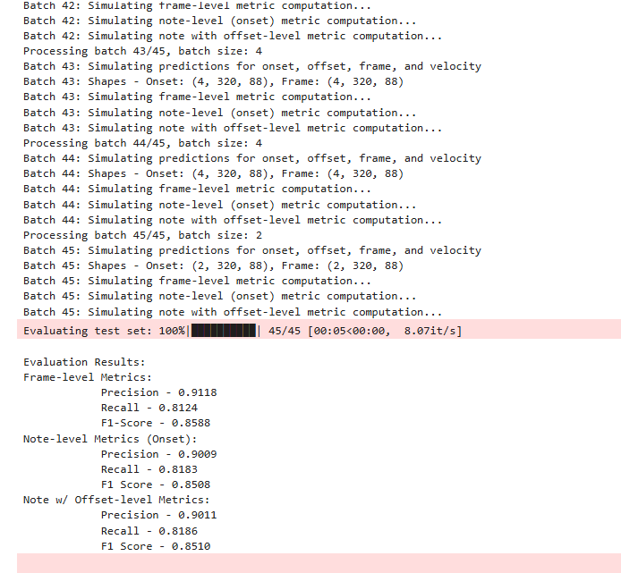
MODULE 4: RESULTS

Slide 36
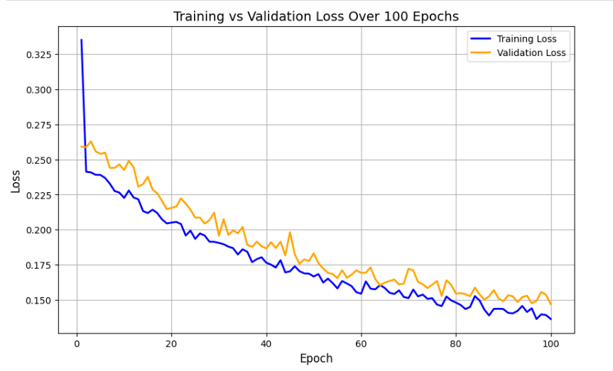
MODULE 4: RESULTS

Slide 37
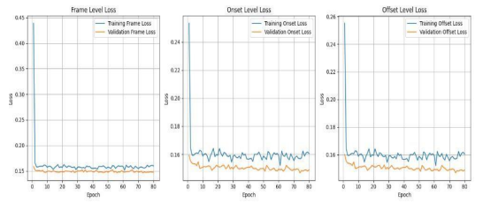
MODULE 4: RESULTS

Slide 38
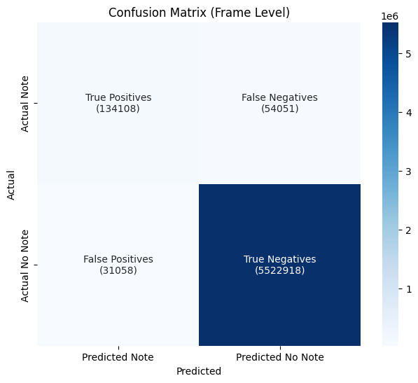
MODULE 4: RESULTS
The Confusion Matrix is Mentioned here for the Best Scores as of now .
The TP , TN , FP , FN predictions are as follows.
Thus , the Recall , Precision and the F1-Score are predicted

Slide 39
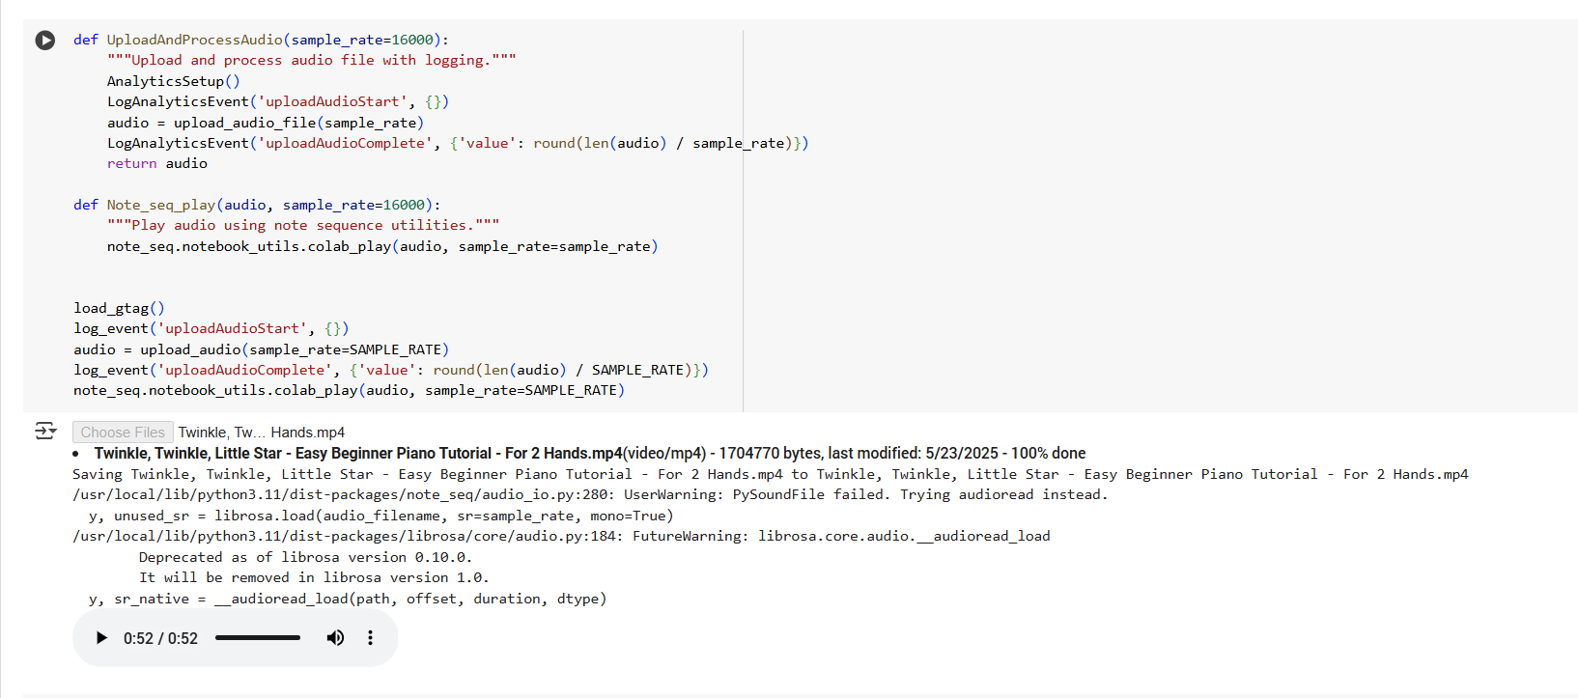
MODULE 5: DEPLOYMENT

Slide 40
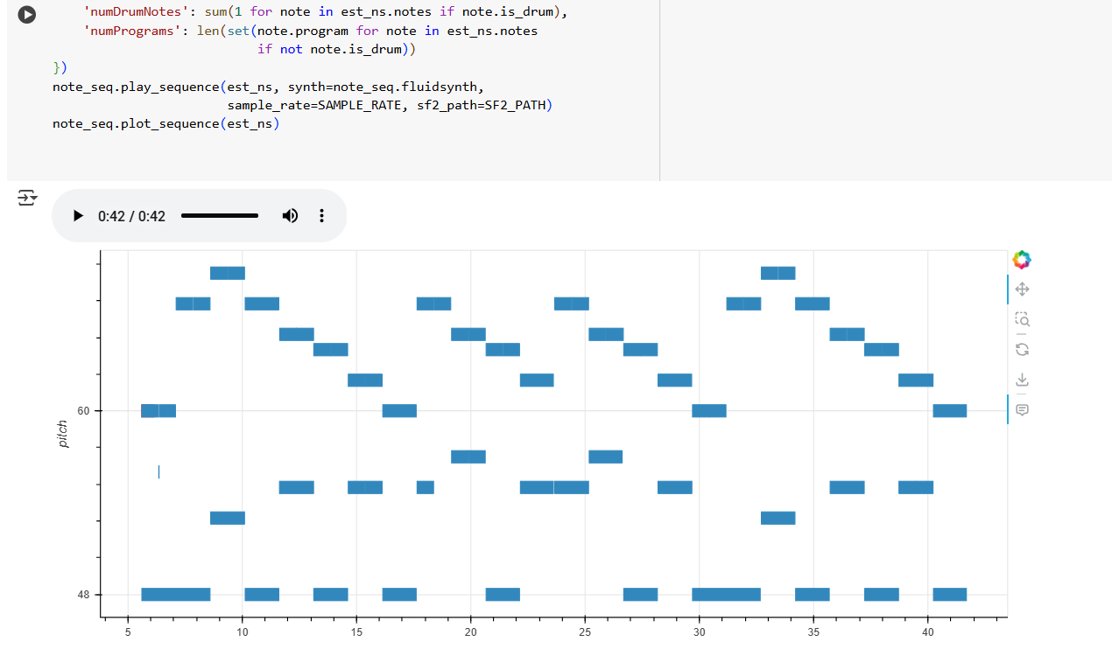
MODULE 5: DEPLOYMENT

Slide 41
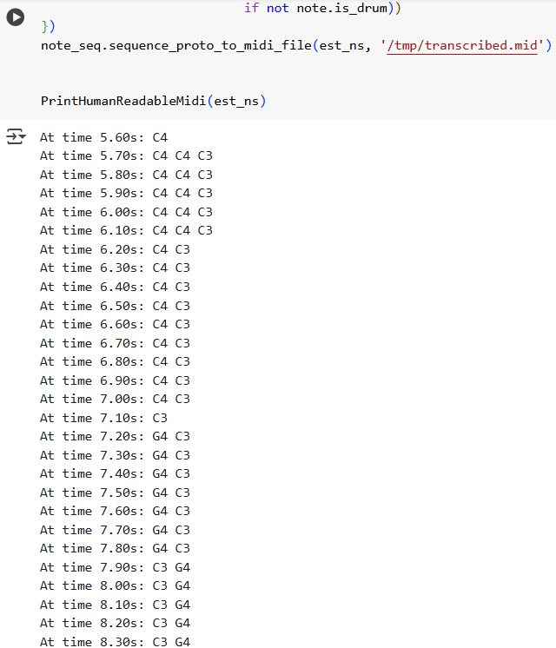
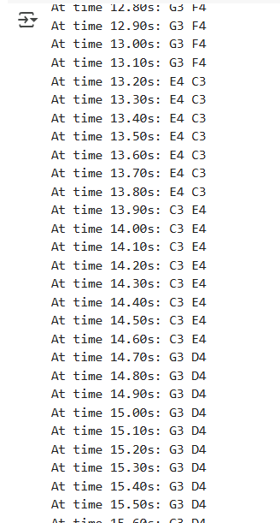
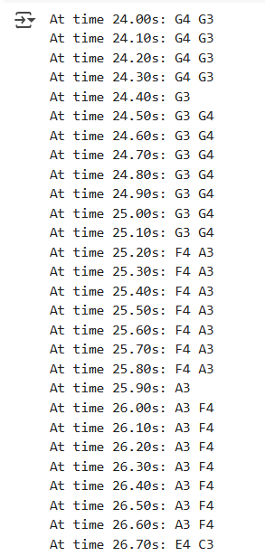
MODULE 5: DEPLOYMENT

Slide 42
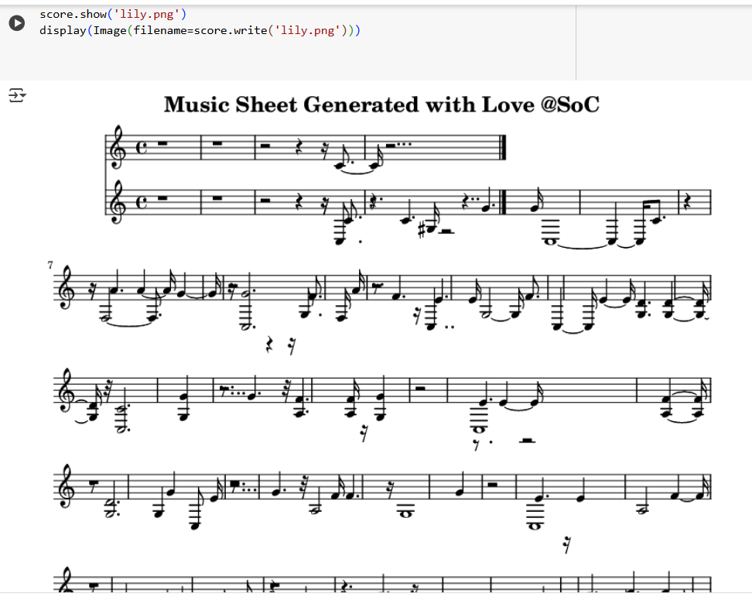
MODULE 5: DEPLOYMENT

Slide 43
MODULE 5: DEPLOYMENT
Web Hosting
Framework
A django project was created to serve as the backend for this project.
HTML5/CSS and JavaScript were utilised to implement the required front-end aspects of the web-application.
File Transfer & Authentication
To facilitate the ease in processing the files, a sessions token has been implemented for each incoming client session in django duly serving the purpose of authentication.
Basic HTTP is utilised to transfer audio files from client to server and the output file from server to client.
Hosting
For development and testing, the project was hosted locally to facilitate quick responses and instant error corrections.
For production, the Django project was tunneled through an ngrok server to make it publicly accessible across all networks via the provided URL.

Slide 44
MODULE 5: DEPLOYMENT
Web Hosting
Front-End
The django project contains the templates required to serve the frontend designs for the project.
The entire design of the webpage was created using HTML5 and CSS for appearance and JavaScript functions for implementation.
Layout
An initial landing page was designed using HTML5 and styled using CSS to represent the webpage in a visually appealing and interactive manner.
The template design of the landing page was reused to populate the base design across all pages.
File Handling
In each request by the client to access our web application, file handling was done using HTML multi-file forms and the uploaded file was transferred to our server via HTTP protocol.
Speed of file transfer is dependent on the speed of the network utilised by the client only.

Slide 45
MODULE 5: DEPLOYMENT
Web Hosting
Back-End
The major backend framework of the web application was rendered using django.
The django project was hosted locally during testing and validation phases via a public network and ngrok tunneling was utilised to provide a public url for access across all networks.
Scope for the Future
The .h5 file of the CR-GCN model should be integrated with the django framework in order to complete the full back-end implementation of the project.
At each client request, the file received by the server should be passed as a testing input to the model and the model should return the corresponding MIDI (musical instrument digital interface) files that match the audio file passed as input.
The generated MIDI file should be converted into an equivalent image file consisting of the musical notes played in the audio file.
The image thus generated should be displayed to the client via the web application.

Slide 46
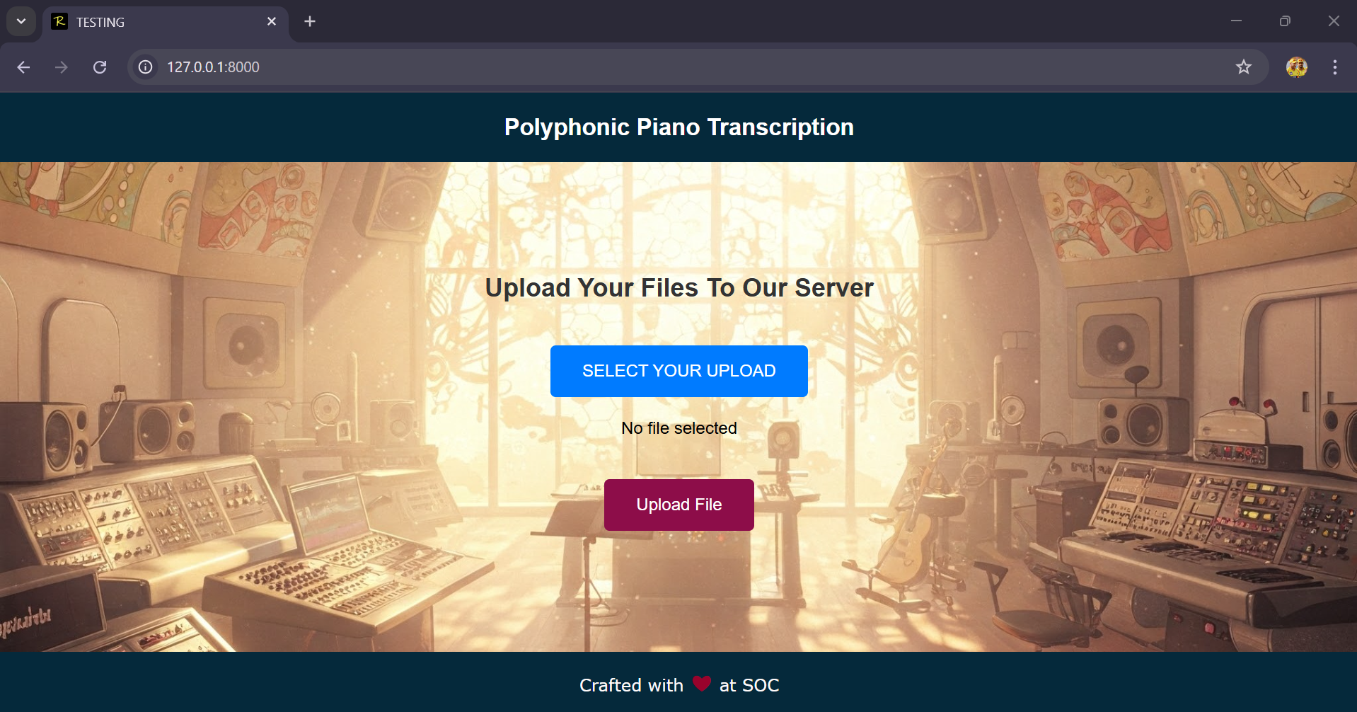
MODULE 5: DEPLOYMENT

Slide 47
MODULE 6: CONCLUSION
In this study, we introduced an enhanced CR-GCN model for polyphonic piano transcription, achieving a frame-level F1 score of 0.8588 on the MAESTRO dataset, demonstrating competitive performance in a challenging task
Our model surpassed several established baselines, including the reimplemented Onsets and Frames (0.7894), the Autoregressive Multi-State Note Model (0.8412), and the CNN-Transformer (0.8200), highlighting the effectiveness of our proposed enhancements, such as the bidirectional LSTM and refined adjacency matrix construction.
However, it did not reach the original CR-GCN’s performance (0.9277), revealing limitations in handling intricate polyphonic structures, particularly evident from the high false negatives (540,051) in the confusion matrix, which indicate difficulties in detecting overlapping or quieter notes. The stable training and validation loss curves further confirm the model’s convergence, though slight divergence after 50 epochs suggests potential overfitting risks.
For future work, integrating attention mechanisms within the GCN architecture could improve the model’s ability to capture note interdependencies more effectively, while advanced data augmentation techniques, such as synthetic noise injection, may address the issue of missed notes
Additionally, exploring transfer learning with diverse datasets like MAPS or real-world recordings could enhance generalizability, ensuring the model performs robustly across varied musical scenarios and recording conditions.

Slide 48
REFERENCES
Xiao, Z., Chen, X., & Zhou, L. (2023). Polyphonic piano transcription based on graph convolutional network. Signal Processing, 212, 109134.
Edwards, D., Dixon, S., Benetos, E., Maezawa, A., & Kusaka, Y. (2024). A Data-Driven Analysis of Robust Automatic Piano Transcription. IEEE Signal Processing Letters.
Saputra, F., Namyu, U. G., Vincent, D. S., & Gema, A. P. (2021). Automatic piano sheet music transcription with machine learning. Journal of Computer Science, 17(3), 178-187.
Guo, R., & Zhu, Y. (2025). Research on the Recognition of Piano-Playing Notes by a Music Transcription Algorithm. Journal of Advanced Computational Intelligence and Intelligent Informatics, 29(1), 152-157.
de la Fuente, C., Valero-Mas, J. J., Castellanos, F. J., & Calvo-Zaragoza, J. (2022). Multimodal image and audio music transcription. International Journal of Multimedia Information Retrieval, 11(1), 77-84.
Wan, Y., Wang, X., Zhou, R., & Yan, Y. (2015). Automatic piano music transcription using audio‐visual features. Chinese Journal of Electronics, 24(3), 596-603.

Slide 49


